Slide 1


Cappy Smart School
School Planning Survey Results 2024
Online Survey Results
March 2024

Slide 2
Background
An online survey was available to Cappy Smart families in March 2024.
The survey had a total of 21 people completing some or all of the survey.
The purpose of the survey was to gather feedback from parents about school planning, which included the school development plan, school budget, and school fees.
This report includes survey results only; comments are provided in a separate document.

Slide 3
Results

Slide 4
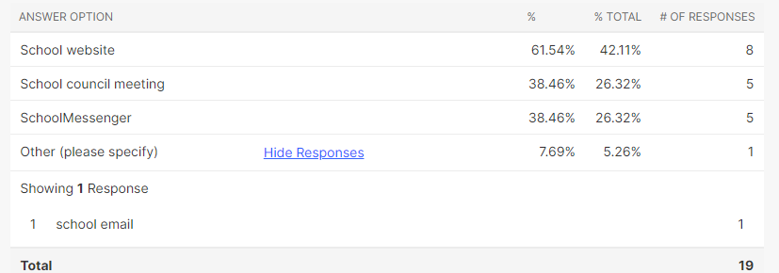
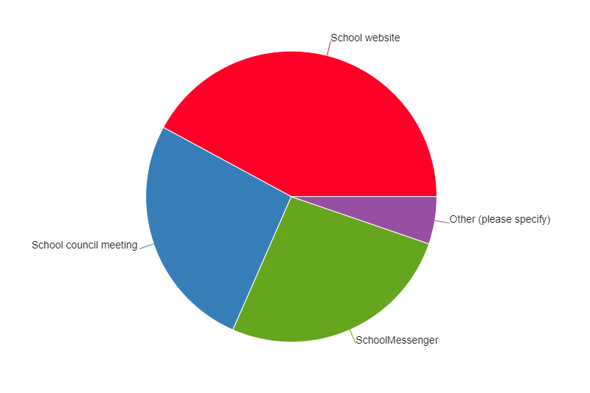
We share SDP information and updates in different ways. Please indicate the ways you have learned about our SDP. Check all that apply.
Responses: 19

Slide 5
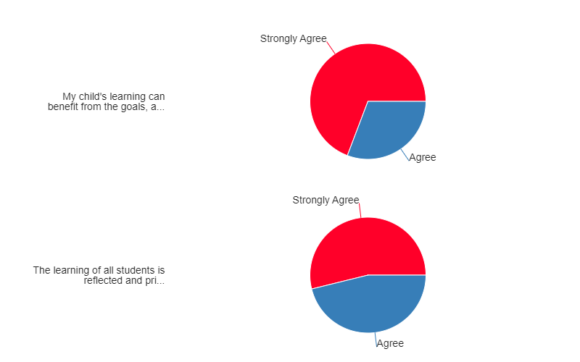
The SDP is developed with all students in mind. Please select your level of agreement with the following statements:
Responses: 13
My child’s learning can benefit from the goals, actions and resources in the SDP.
The learning of all students is reflected and prioritized in the goals, actions and resources in the SDP.

Slide 6
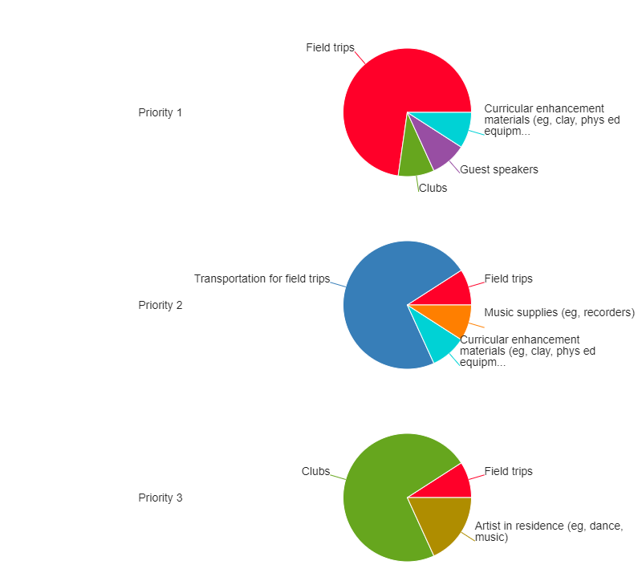
Schools must operate within their budget and too many fees can be unmanageable for families. Knowing that, please rank the following activities and services in order of importance to you.
Responses: 11

Slide 7
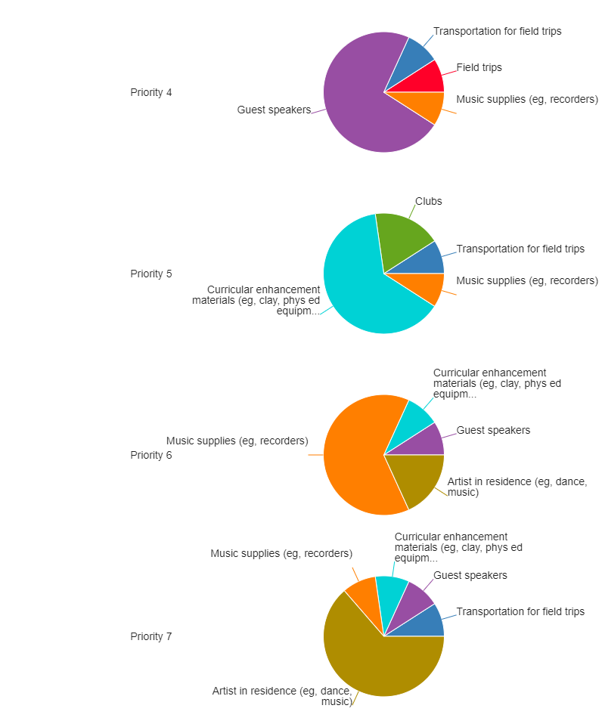
Schools must operate within their budget and too many fees can be unmanageable for families. Knowing that, please rank the following activities and services in order of importance to you.
Responses: 11

Slide 8
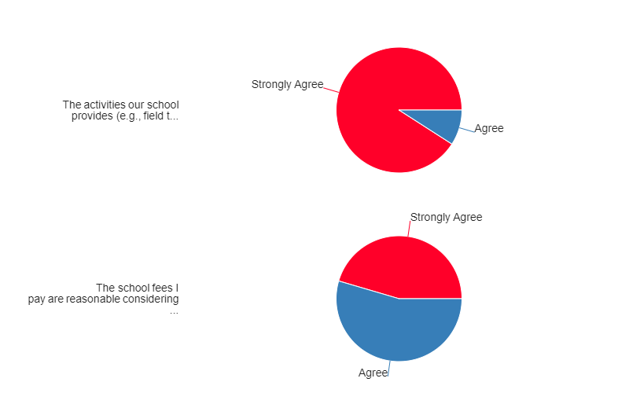
Please select your level of agreement with the following statements:
Responses: 11
The activities our school provides (eg. Field trips, guest speakers, experts in schools, sporting activities, outdoor education etc.) are important for my child’s learning.
The school fees I pay are reasonable considering the benefit they provide my child.

Slide 9
Conclusion

Slide 10
Thank You!
Survey comments are available on the Cappy Smart School website.
Thank you to everyone who participated in this survey. Your contributions made a meaningful difference in our decision-making process, as families are our partners in education.

